Slide 1


Auto Invoice

Slide 2

Agenda
Feature Overview
Setup to Implement the Feature
Invoices with Rules
Determining Dates
EBTax integration
Auto Invoice code flow
Q&A

Slide 3
Feature Overview
AutoInvoice is a powerful, flexible tool to import and validate transaction data from other financial systems and create invoices, debit memos, credit memos, and on-account credits in Oracle Receivables.
Data from external systems is fed into the Autoinvoice interface tables. AutoInvoice processes the data in the interface tables to create invoices, debit memos, credit memos, and on-account credits in Oracle Receivables.
AutoInvoice ensures that the data imported is accurate and valid
AutoInvoice can also initiate receipt handling when importing credits against paid
invoices.
I

Slide 4
Feature Overview
AutoInvoice uses four interface tables:
RA_INTERFACE_LINES_ALL
RA_INTERFACE_DISTRIBUTIONS_ALL
RA_INTERFACE_SALECSREDITS_ALL
AR_INTERFACE_CONTS_ALL
AutoInvoice reports validation errors using RA_INTERFACE_ERRORS_ALL table
AutoInvoice can be submitted using the following programs:
AutoInvoice Master Program
AutoInvoice Import Program
AutoInvoice Purge Program deletes the interface lines that were processed
and successfully transferred into Receivables by the AutoInvoice Import program.

Slide 5
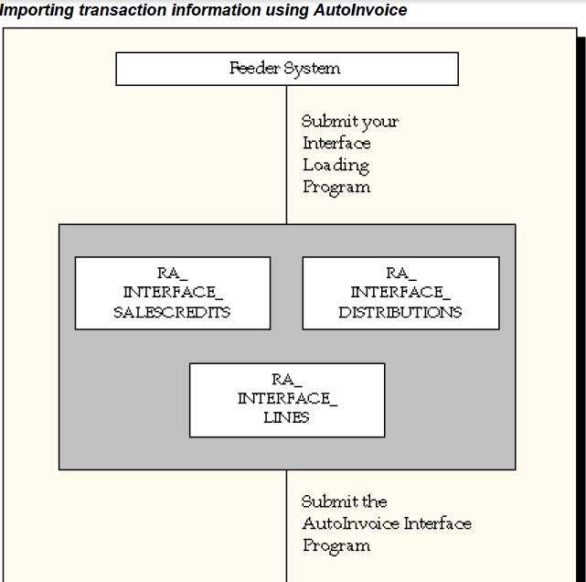
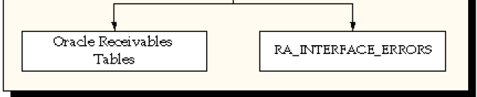
Feature Overview

Slide 6
Setup to Implement the Feature
Customers
Currencies
Calendar/Accounting Periods
Payment Terms
Transaction Types
Auto Accounting
Transaction Flexfields
Line Ordering Rules
Grouping Rules
Batch Sources
System Options
Other Setups

Slide 7
Setup to Implement the Feature
Add or import customers, if your original system contains data for customers that are not yet defined in Receivables.
Add currencies to Receivables if your original system uses currencies not yet defined in Receivables.
Add payment terms to Receivables if your original system uses payment terms not yet defined in Receivables.
Add transaction types to Receivables if your original system uses transaction types not yet defined in Receivables.
Open or close periods in the accounting calendar to control the recording of accounting information for these periods. Since the objective of AutoInvoice is to create new transactions, the goal is to have these transactions impact open GL periods.

Slide 8
Setup to Implement the Feature
Auto Accounting: AutoAccounting is a powerful, flexible, and time saving feature that automatically creates the general ledger Accounting Flexfields
Receivables creates default accounts for revenue, receivable, freight, tax, unearned revenue, unbilled receivable, late charges, bills receivables accounts, and AutoInvoice clearing (suspense) accounts using this information.
Auto Accounting will be used to derive Accounting Flexfields if no data is passed through RA_INTERFACE_DISTRIBUTIONS_ALL table

Slide 9
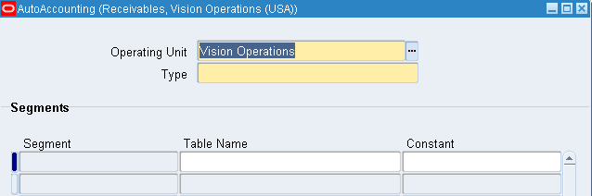
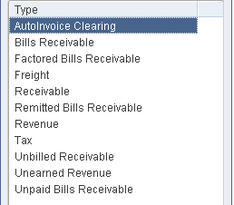
Setup to Implement the Feature
Navigation: Receivables Manager->Setup->Transactions->AutoAccounting
For each segment, enter either the table name or constant value that you want
Receivables to use to get information.
Table Names: Bill To Site, Drawee Site, Remittance Banks, Salesreps, Standard Lines, Taxes and Transaction Types.
If you did not enter a Table Name, enter a Constant value for this segment

Slide 10
Setup to Implement the Feature
Receivables uses the Transaction Flexfield to uniquely identify each transaction and transaction line you import through AutoInvoice. Transaction Flexfields are also used to refer to and link transaction lines.
Types of Transaction Flexfields:
Line Transaction Flexfield
Invoice Transaction Flexfield
Reference Transaction Flexfields
Link-To Transaction Flexfields
Line and Invoice Transaction Flexfields are mandatory

Slide 11
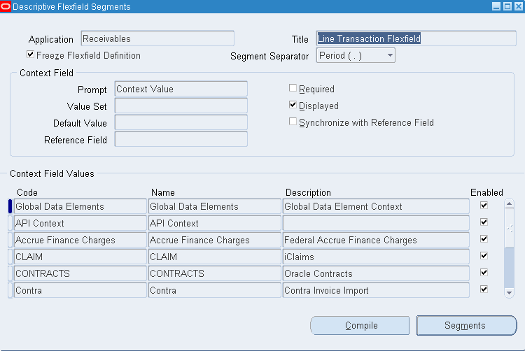
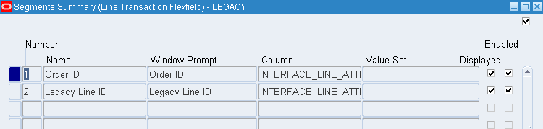
Setup to Implement the Feature
System Administrator->Application->Flexfield->Descriptive->Segments

Slide 12
Setup to Implement the Feature
Line Ordering Rules: Define ordering rules used by AutoInvoice to determine how to order your transaction lines. AutoInvoice randomly orders lines on your transaction if line ordering rules are not defined.
Grouping Rules: AutoInvoice uses grouping rules to determine how to create your transactions. Grouping rules are required if you use AutoInvoice. AutoInvoice uses the following hierarchy when determining the grouping rule to use:
Transaction batch source
Customer site level
Customer profile level
System Options window

Slide 13
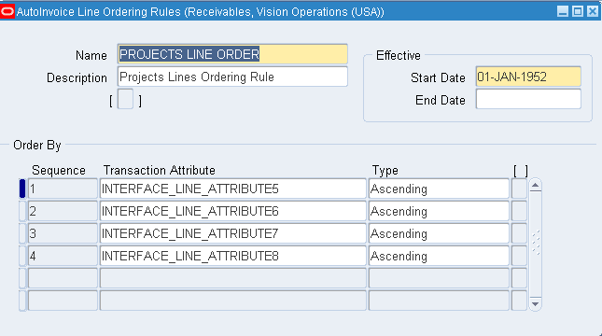
Setup to Implement the Feature
Setup->Transactions->AutoInvoice-> Line Ordering Rules

Slide 14
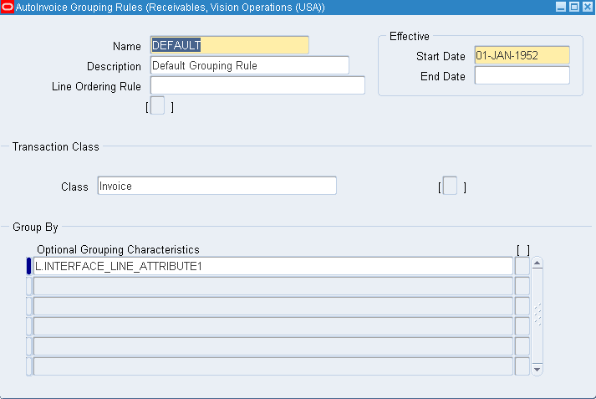
Setup to Implement the Feature
The columns defined here are in addition to the mandatory grouping columns. All columns that map to transaction header will be mandatory grouping columns.
Setup->Transactions->AutoInvoice-> Grouping Rules

Slide 15
Setup to Implement the Feature
Transaction Batch Sources: Batch sources control the standard transaction type assigned to a transaction and determine whether Receivables automatically numbers your transactions and transaction batches.
A batch source provides default information, which we can optionally change at the transaction level.
Two types of Batch Sources can be defined:
Manual
Imported

Slide 16
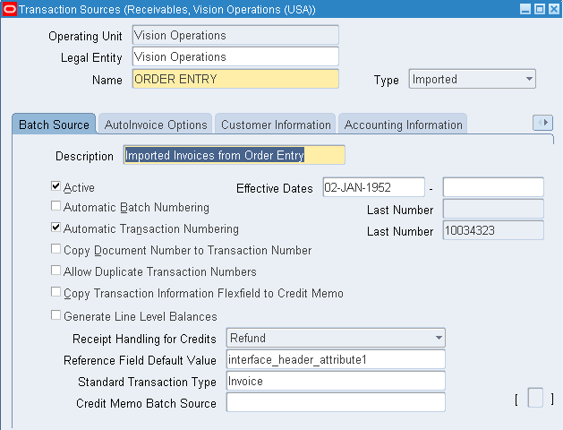
Setup to Implement the Feature
Setup->Transactions->Sources

Slide 17
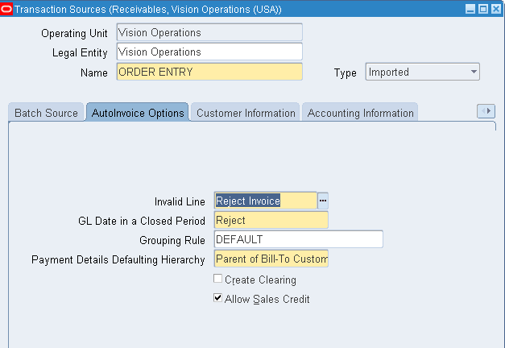
Setup to Implement the Feature
Setup->Transactions->Sources

Slide 18
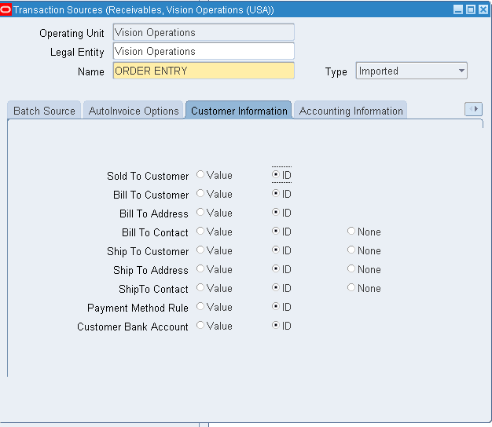
Setup to Implement the Feature
Setup->Transactions->Sources

Slide 19
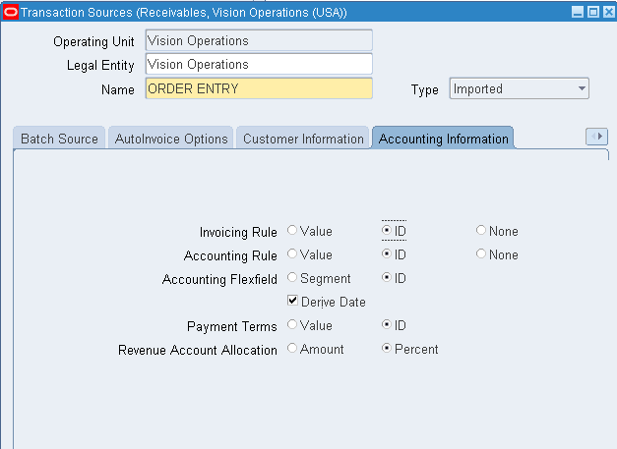
Setup to Implement the Feature
Setup->Transactions->Sources

Slide 20
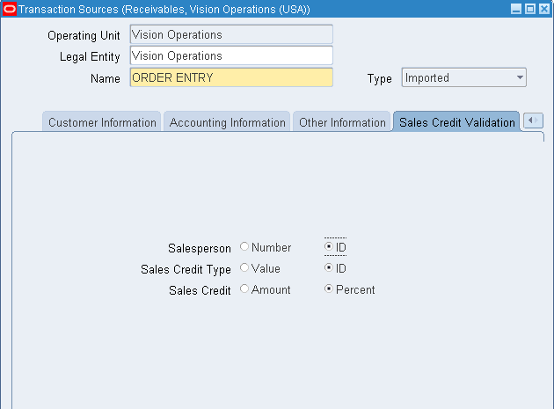
Setup to Implement the Feature
Setup->Transactions->Sources

Slide 21
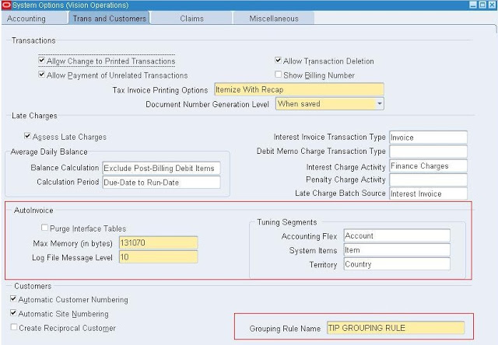
Setup to Implement the Feature
Manage Receivables System Options

Slide 22
Setup to Implement the Feature
Other Setups
Add salespersons to Receivables if your original system uses salespersons not yet defined in Receivables.
Add accounting rules to Receivables if your original system uses accounting rules that are not yet defined in Receivables.
Add units of measure to Receivables if your original system uses units of measure not yet defined in Receivables.
Add freight carrier codes to Receivables if your original system uses freight carriers not yet defined in Receivables.

Slide 23
Q&A

